Slide 1

Orange Class Parent's/Carer’s Meeting
Reading/Phonics/Tapestry/Baseline Meeting

Slide 2


Introduction
Today's meeting is going to explain how we teach reading in our school. We will also be talking about how you can support your child at home to develop a love of reading.
In class we have many opportunities to share books with the children. We have a daily story time which allows us to share our favourite books, whole class reading, group, individual reading and also buddy reading with our Y6 buddies. We are also lucky enough to be able to visit " Magical Storyland" - School library once a week.

Slide 3
Children's Development
All children have developed an awareness of different sounds in spoken language from a very early age.
Spoken words are made up of different sounds.
In Phonics the children will learn how to match these sounds to letters.
The children will then be able to use this when they are reading and writing.

Slide 4

Rocket Phonics
We follow the Rocket Phonics scheme at Ethelbert Road primary School.
The sounds that children learn are taught in a specific, systematic order (not alphabetically) so that children can begin to build words from these sounds as early as possible.
Phonics supports children to hear, identify and link the sounds that letters make (phonemes) to what the letters look like when written down (graphemes).
This helps children to recognise and read words, using knowledge of the sounds to read new or unfamiliar words

Slide 5
In Class
We have daily phonics sessions which introduce and revisit sounds
( phonemes) .
In their Rocket Phonics lessons, your child will learn to recognise, identify, say and read all of the 44 sounds of the English language along with writing and spelling them. They will revisit sounds they have learned, learn new sounds, take part in stimulating activities to practise and apply their reading, writing and spelling skills and contribute to comprehension quizzes to check for understanding.

Slide 6
Book bags
We have been sending home a 'sharing book' in your child's book bag since week 1.
This book is intended for you to share together , to discuss the pictures, to encourage your child to hold the book and scan from left to right and also to foster the love of stories.
We have now introduced some wordless books alongside their sharing book- this again will encourage these vital pre reading skills.
When your child is ready, we will begin to send home some decodable Rocket Phonics books for your child to read at home.
Reading Records- For you to fill in - date, comment, signature. Please do fill this in every time you hear your child read / share a story. It is ok to re-read the same book as this can help your child to feel like a reader.
Key words and sounds book- Pink book which contains the sounds / words that your child has been learning. Please tick the sounds and words that your child knows. We will put new sounds in when your child is able to pronounce them correctly.

Slide 7
Reading Days
Elephant’s- will change their books on a Monday.
Panda’s – will change their books on a Tuesday.
Tiger’s – will change their books on a Thursday
Lion’s- will change their books on a Friday.
All children will have a wordless book/ decodable book and a sharing book.
Pink book containing the sounds and tricky words that we have taught.

Slide 8
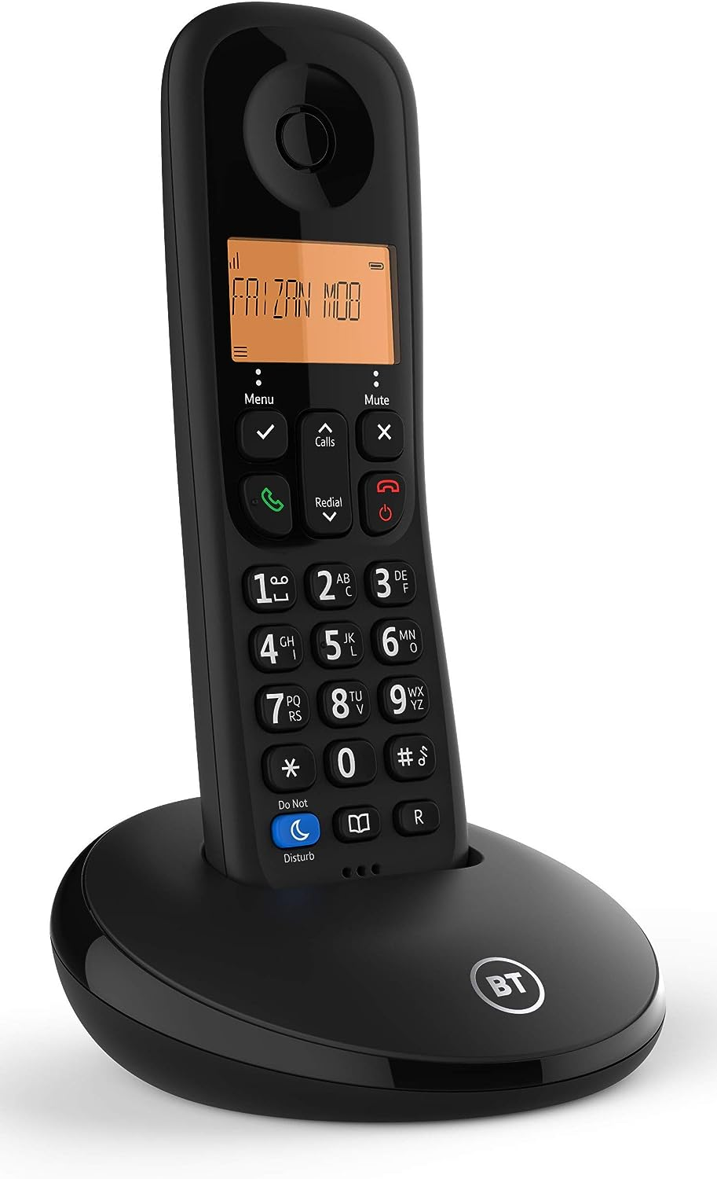
Language used in school during phonics sessions.
Phoneme: A phoneme is the smallest unit of sound in a word
Grapheme: A grapheme is the letter or letters that are used to represent the phoneme ( sound) a
Digraph: A digraph is two letters that make one sound eg sh
Trigraph: Three letters that make one sound eg igh

Slide 9
How to pronounce the sounds
Lots of children come to school knowing the capital letter, or to pronounce the sounds with a schwar at the end .
It is very important that the children are producing the pure sounds as this will support them when they are blending sounds together to read a word.
Please see the link for the correct pronunciation.
Pronunciation of phonics sounds in Reading Planet Rocket Phonics: Pink A/Phonics Phase 2 - YouTube
The links are also on our class page in our Literacy Zone if you would like to refer to it.

Slide 10
Blending
Blending to read
This is when the sounds are said and put together to read the words.
pin mat sat
shed tail light

Slide 11

Segmenting
Using phonics skills to support spelling and writing. Children listen to the whole word and break it up into the letter-sounds. E.g. ‘mat’ can be segmented as m-a-t.
We use our fingers to count the sounds.

Slide 12
Nonsense / Alien words
We teach the children to read real words and alien words- nonsense words , for example
Taf shet

Slide 13
Tricky Words
Tricky words are words that can not be sounded out.
We have to learn these words by sight.
the I to no
go into

Slide 14

How can you support your child with their reading?
Make it fun!
Post it notes around the house with sounds/ words on
Treasure hunts with clues to read along the way
Go on a sound hunt in the garden/ house.
Target practice: Hit the grapheme or word with a football
Read at the supermarket/ magazines/ shop signs.

Slide 15
Partnership with Parents/ Carers
We want to work with you to support and guide your children to becoming readers who not only are capable of reading the words on a page but also who have a life long love of books.
Thank you for listening to our presentation and if there are any questions , please feel free to ask us either now or at any point.

Slide 16

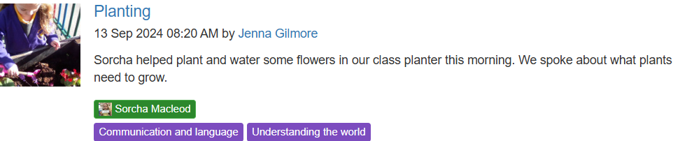
Tapestry
‘Tapestry’ is an exciting
way of building a strong
link between home and
school.

Slide 17

Why are we using Tapestry?
We can celebrate and share your children’s learning by adding photos and videos.
We will discover your child's interests and experiences outside school as you will also be able to add your own observations.
You will be kept up to date about your child's development .
We can share learning opportunities and ideas with families.

Slide 18
How can parents engage?
You will have received a letter regarding the use of Tapestry Online Learning Journal in our setting.
This details how to access your account using your email address. This account will be directly linked to your child/ren’s account/s, which means you will only be able to see observations that include your child. You will then be able to login with your email address and password to either the browser version of Tapestry (tapestryjournal.com) or to the app. Tapestry has apps for iOS, Android and Amazon Fire devices. If you choose to use the app, after you login initially, you can use a 4-digit PIN to quickly log back in.

Slide 19
How can parents engage?
If you would like to proceed, please check that you have filled in the slip with your child’s name and your email address and then sign and return to school.
Once this has been received, we can then link and activate your tapestry account.
If you have any difficulties, please contact me.

Slide 20
Baseline
The Reception Baseline Assessment (RBA) is a short, interactive and practical assessment of your children's early literacy, communication, language and mathematics skills when they begin school, using materials that most children of your child's age will be familiar with. It is statutory for all schools from September 2021 and must be completed in the first 6 weeks of your child starting school.
The RBA will provide an opportunity for your child to have valuable one-to-one time with their teacher at an early stage, so that the teacher can get to know your child better. It will provide a helpful snapshot of your child so that they can be supported in the most appropriate way.
You do not need to do anything to prepare your child for the assessment. Your child is unlikely to even know that they are doing an assessment when they are completing tasks and activities.
If you would like any further information on RBA please look on the class page on the school website.

