Slide 1

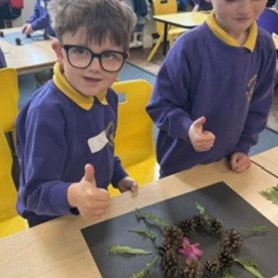
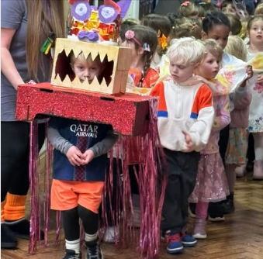
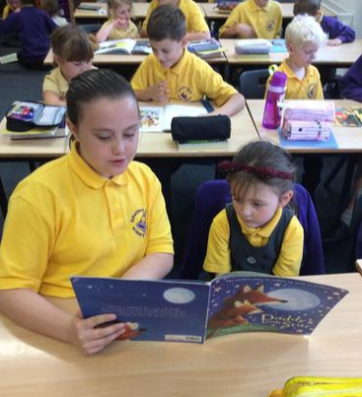
Starting School
AT Ethelbert Road
Together We Thrive

Slide 2
Key Staff
Class Teacher: Mrs Sally Rix
Teaching Assistant: Mrs Da Costa/Miss Willis
Headteacher: Mrs Michele Kirkbride
Deputy Headteacher/SENCO: Mrs Lisa Vitiello
Mental Health and Well being Manager: Mrs Claire Cornall

Slide 3

Governors

Slide 4

Safeguarding
Safeguarding our children is a very important part of our practice and it is important that parents are confident and knowledgeable about the school’s arrangements to keep their child safe. Information for parents can be found on our website under the Our School tab: https://www.ethelbert-road.kent.sch.uk/safeguarding/

Slide 5
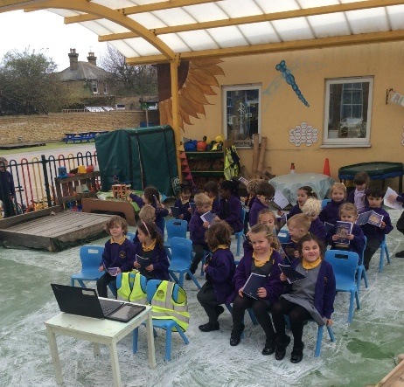
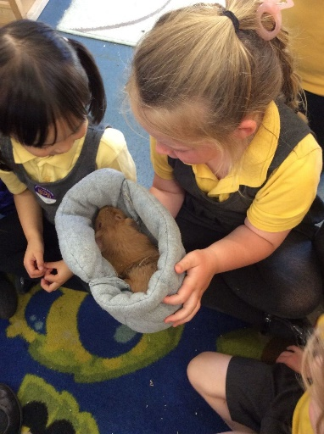

Early Years
Children learn through:
Playing and exploring
Finding out and exploring
Playing with what they know
Being willing to have a go
Active learning
Being involved
Keeping trying
Enjoying achieving what they set out to do
Creating and thinking critically – thinking
Having their own ideas
Making links
Choosing ways to do things

Slide 6
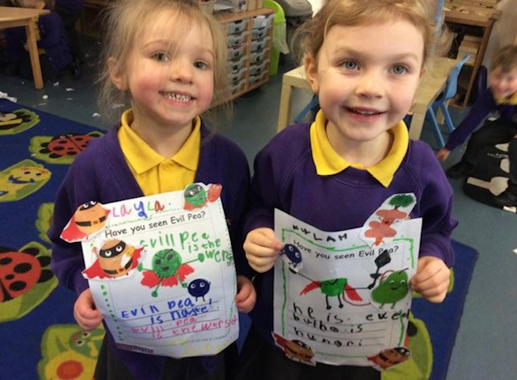
The Early Years Foundation Stage
Reception is part of the Early Years Foundation Stage (EYFS) so we follow the EYFS curriculum. The children’s daily learning builds upon nursey and home experiences and is rooted in hands on experiences, learning from play and child initiated experiences and lots of talk for learning. The children undertake a Baseline Assessment in the first 6 weeks of school and this helps the school track your child’s progress over time. In the summer term the children are assessed on the Early Learning Goals and this is reported to parents and carers through a school report.
There are 7 areas of learning
Communication and Language
Physical Development
Personal Social and Emotional Development
Literacy
Maths
Understanding The World
Expressive Arts and Design

Slide 7
Early Reading Skills and Phonics
We follow Rocket Phonics. It is a fun way to teach children to read and write.
We use flashcards, big books, daily workbooks and class texts.
We allocate reading books to go home and you can access the online EBooks.
In their Rocket Phonics lessons, your child will learn to recognise, identify, say and read all of the sounds of the English language along with writing and spelling them.
We will hold a parental reading meeting in the Autumn term to explain this further.

Slide 8
Special Educational Needs and Disability (SEND)
Mental Health and Well-being
Our SENCO is also our Deputy Head teacher Mrs Vitiello
Mrs Cornall is our MHWB Manager
Inclusive and personalised approach
Early identification of additional needs
External advisors
Work closely with families

Slide 9

Website
https://www.ethelbert-road.kent.sch.uk/
If you go to Class Pages and click on YR starters 2026 you will see the video to share with your child of a typical day in the class
You can also see lots of other information such as the school brochure, and a starting school tick list
We have our own YR class email so that you can always contact us. YR@ethelbert-road.kent.sch.uk

Slide 10
Uniform
Please ensure all items are named
Purple sweatshirt, cardigan or fleece with school logo
Gold polo shirt (Logo or no logo).
Smart grey trousers/shorts, grey skirt or pinafore dress, Check dress (purple/Yellow) or pinafore dress (grey).
Easily fastened Coat – please send coats every day
White, grey or black socks or tights
PE kit – Purple hoody (with logo), purple T-Shirt (with logo), black shorts/black joggers/leggings, black trainers
Book bag with logo
Flat black shoes (no trainers, high heels, crocs or open toe sandals. Any sandals need an ankle strap).

Slide 11
Uniform
No jewellery (unless authorised by the Headteacher for religious, SEND or medical reasons). Small plain stud earrings only.
PE Kit to be worn on PE day (You will be notified when PE sessions will start). Purple hoody with logo, Purple T-shirt with logo, black shorts, tracksuit bottoms or leggings, sports trainers or plimsoles.
Long hair (to the shoulders) to be tied back. No extreme hair styles such as sculptured, names r patters, symbols, Mohicans, or dyed.
Please ensure that names are in EVERYTHING!
A pair of named wellies to stay in school
Please speak to the SENCo if you need amendments to the uniform for your child

Slide 12
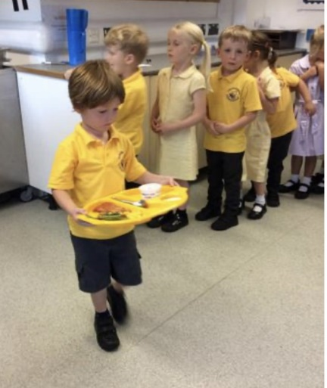
School Dinners
Every child from Reception to Year 2 is entitled to a free school dinner known as Universal Free School Dinners and provided by the Government.
Our meals are cooked off site and delivered daily. Our menu can be found on our website and you can make the decision for your child to have a free school meal every morning when dropping off. The children can choose a meat dinner (red), vegetarian dinner (green) or a jacket potato.

Slide 13

Wrap Around Care
Breakfast Club from 7.55 am
After School Care until 5.30
See our website for further details and how to book

Slide 14
Attendance and Medical Needs
Good attendance is really important throughout school life and beyond. We aim for high attendance and any child who falls below 95% becomes a concern; children with attendance below 90% are viewed a ‘persistent absentee’. All leave in term time MUST be authorised by the Headteacher.
Absence
Any absence requires a telephone call to the school office by 9:15am.
The school expects children to have 95% attendance. Your child’s attendance is carefully tracked and reported to the Local Authority Attendance Officer.
Holidays in term time will not be authorised and parents/carers are requested to book holidays in the school holidays. Every day at school counts and missed learning will not be revisited. Learning is built upon from week to week and year to year so if your child misses their learning due to holidays being taken in school time they may end up with gaps in their learning as they progress with their education.
Sickness
Please let the teacher, or office staff know if someone different is collecting your child. For safeguarding reasons we can not let your child go home with someone we have not been notified is collecting for you.
Any sickness or diarrhoea, must be followed by at least 48 hours absence.
Medical
Any prescribed medication can only be administered by prior arrangement with the school office. We only give antibiotics to children if they have been prescribed it four times a day and any medications requires a form to be completed. Medical forms will be completed by the parents and SENCo for any medical needs including asthma.

Slide 15

Our School Rules
Be Safe, Be Kind, Be Ready
Our Values
Creativity, Cooperation,
Self-belief, Happiness, Respect and Curiosity

Slide 16
How you can prepare your child to be ready for school
Help you child to:
Have a routine and boundaries at home, including bedtime
Use the toilet independently
Be used to leaving you and being with other children
Dress and undress independently
Recognise their name
Learn how to put on and do up their coat independently
Learn how to blow and wipe their nose independently
Speak to the class teacher or SENCo if you are worried about your child being school ready

Slide 17
Key Dates
Play and Stay 1 – Tuesday 23rd June - 9.30-10.30/1.30-2.30.
Two groups of 15 children and parents/carers
Play and Stay 2 – Thursday 2nd July– 1.30-2.30. All 30 children and an opportunity for parents/carers to meet in our outdoor classroom
Individual Visits - 7th ,9th ,10th July - sign up sheets are in Hall
School starts –Wednesday 2nd and Thursday 3rd September –15 Children am (9am – 11am) and 15 children pm (1-3pm)
Friday 4th September- All 30 children in 9-1.30pm (staying for lunch)
Monday 7th September onwards – Children in full time 8.40-3.10

Slide 18
Finally
We want your children to love learning both at home and school. If children are happy at school they will develop and make progress.
We look forward to developing a partnership with you as your child continues their learning journey at Ethelbert Road Primary School.
Together We Thrive

