Slide 1

Welcome to Year 1

Slide 2
The purple class team
Miss Clark – Class Teacher
Mrs Jago – Teaching Assistant
Miss Willis – Teaching Assistant (Wednesday)
Mrs Salt – Spanish Teacher (Tuesday mornings)
Mrs Vitiello – PPA cover (Mondays PM)
Miss Brown – Sports Coach

Slide 3

Meet Our Governors

Slide 4

Safeguarding
Safeguarding our children is a very important part of our practice and it is important that parents are confident and knowledgeable about the school’s arrangements to keep their child safe. Information for parents can be found on our website under the ‘Our School’ tab.
https://www.ethelbert-road.kent.sch.uk/safeguarding
If you would like any further information or have any questions, please do not hesitate to contact Mrs. Kirkbride (Headteacher and DSL) at headteacher@ethelbert-road.kent.sch.uk

Slide 5
The Year 1 Curriculum
To ensure a smooth transition from YR to Y1, we are offering a creative, play based curriculum, where all children can access learning experiences which appeal to them. To ease their transition, we have deliberately designed our classroom layout to mimic that of Reception’s so that the children are learning in an environment that is familiar to them. The classroom is organised so that there is space for construction, role-play, creative experiences, exploration, and investigation.
Our aim is to deliver the Year 1 curriculum by planning activities based around a core text and to set up indoor and outdoor learning environments that provide stimulating challenges which enable the children to make rapid progress in their learning and development.
We are keen to promote warm, positive relationships with the children within a culture of high expectations for all.
They will be discrete times each day for teaching the core subjects of English and Mathematics as well as Rocket Phonics but the children will also have access to a range of independent activities to write for a range of purposes, as well as to explore cross-curricular learning. Specific skills and knowledge will be taught in a mixture of whole-class, small group, and individual sessions.
As the children progress throughout their time in Year 1, they will be encouraged to work more independently. We will adjust their mix of learning through play and more formal teaching as well as the balance between adult-led and child-initiated activities.

Slide 6

Contacts
Email me: y1@ethelbert-road.kent.sch.uk
Communication between parents and teachers is vital – even the smallest shared issue may have an impact on the child’s wellbeing/learning/behaviour for that day/week/month.
I will check my emails Monday – Friday every morning and between 3.30-4.00pm.
I may not be able to respond on the same day, however, please be reassured I will respond in 3 school days.
If you have an urgent issue, please contact school via the school office. Continue to email the office at office@ethelbert-road.kent.sch.uk with any absence/holiday/medical issues and general enquiries.

Slide 7


Website
Please do check the Year 1 Class Page on the Website. This will be updated weekly with photographs to show what we have been up to.
Spellings will be uploaded every Friday for checking the following Thursday.
The first spelling check will take place on 25th September.

Slide 8
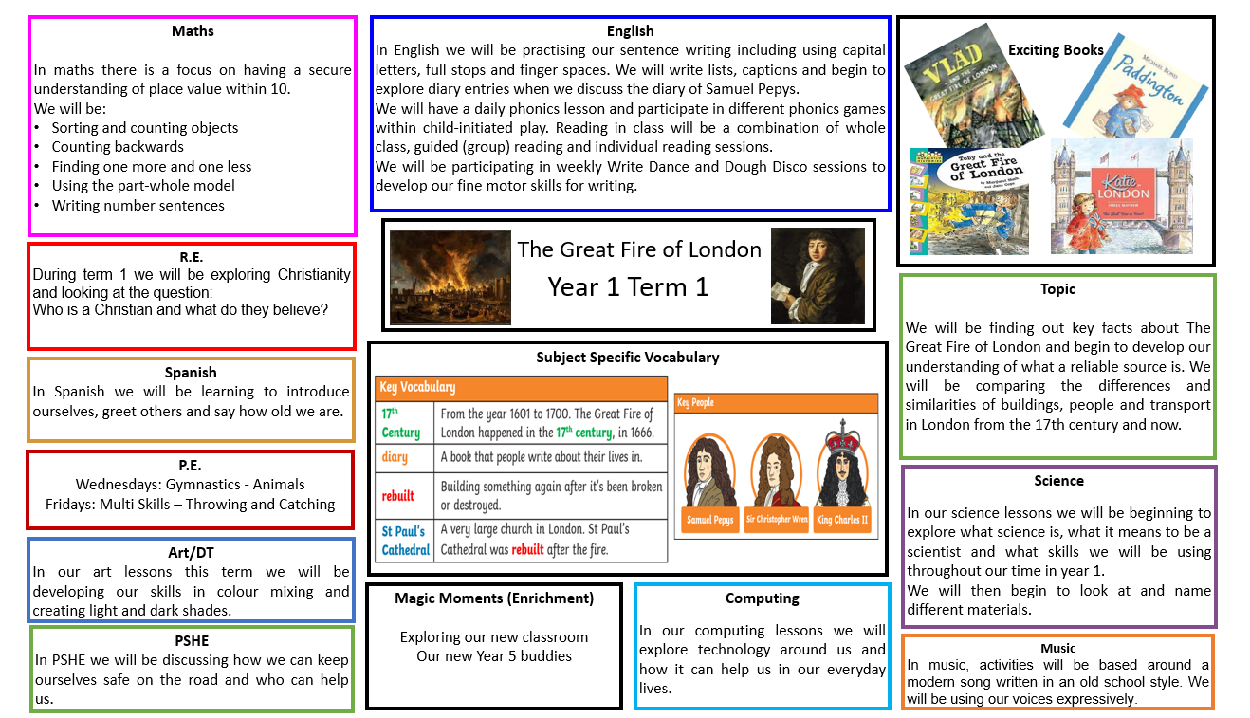

Termly Curriculum Map
This identifies the specific topics that we will cover for the different subjects/areas of the curriculum during the next term and is available on the website.
It can be found via the curriculum tab.

Slide 9
Drop-off and Pick-up Times
The children will continue to enter and exit the school via our Purple Class door.
The gate will open at 8:35am. The class door will open at 8.40am and collection is at 3:15pm – thank you all for being so prompt with this.
Please help us to be vigilant during drop off and pick-up times. It is important that we can see the children going with their grown-ups.
If someone else is collecting your child, please let us know in the morning or contact the office (they will pass a message on to us). Thank you.

Slide 10
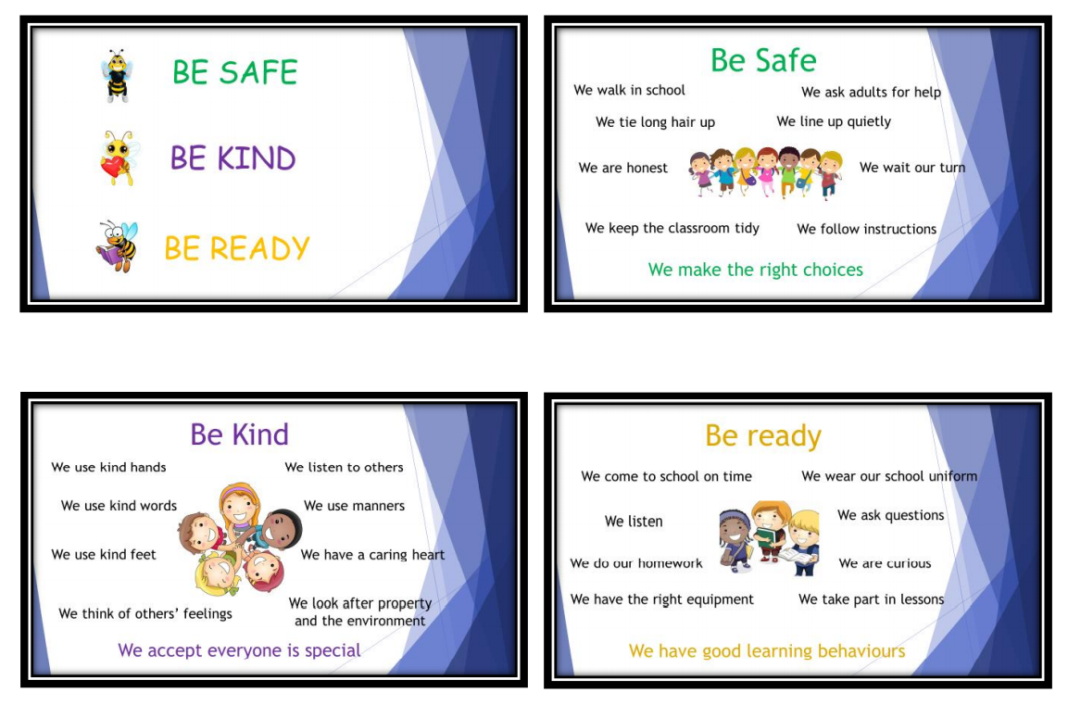
Our School Rules

Slide 11

Recognition board, House Points &
Celebration assembly
Each week we will decide, as a class, upon something that we wish to improve. This target will be related to one of our 3 School Rules. The aim is for every child to get their photo moved up on the Recognition Board by the end of the week for achieving that target.
Throughout the week children can also earn house points.
Our Celebration Assembly will take place on Friday afternoons where the children will receive a Star-Bear Certificate for their achievement.

Slide 12
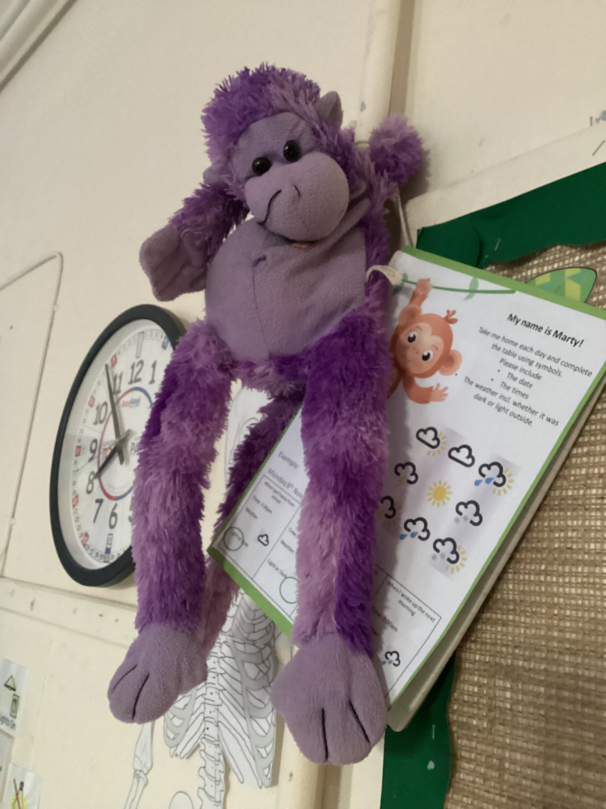
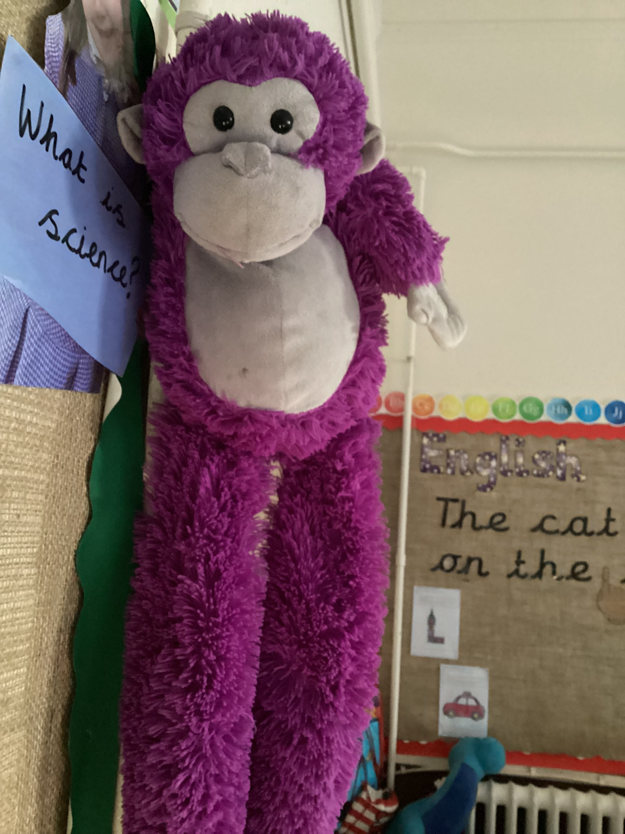
Introducing Marty and smARTY
Throughout the year your child will have an opportunity to bring Marty or Smarty home.
They are to support your child’s learning and interest in Science.

Slide 13

Show and Tell
Show and tell will be at the end of the day on Tuesdays and Thursdays.
This is an opportunity for your child to share something from home, a certificate from a club or to share any news they might have.
Please can these not be toys. Ideas can include – books, pictures, examples of writing and photos.
Other children will then have an opportunity to ask questions.
You can email photos to the class email
y1@ethelbert-road.kent.sch.uk

Slide 14
Topics for the Year
Term 1: The Great Fire of London
Term 2: The Polar Regions (Trip to St Mary’s Church)
Term 3: Significant Explorers (Astronauts in Training Day)
Term 4: Florence Nightingale and Mary Seacole (Kent Life Victorian Day)
Term 5: Local Study of Faversham (Faversham Treasure Hunt)
Term 6: The Great Outdoors – Australia (Australia Fun Day and Wildwood)
*Trip to Turner Contemporary Art Gallery and Thanet Synagogue (TBC)

Slide 15

ROCKET PHONICS
Rocket Phonics is our phonics scheme that is implemented throughout the school. Phonics lessons are taught daily to the whole class and pupils will work through their workbooks during each lesson.
In year 1 your child will be learning 2 new sounds per week (Monday-Thursday) and will be enhancing their skills in blending and segmenting to aid their reading and writing.
Fridays will be ‘Fantastic Phonics Friday’ where we will be looking at common exception words and playing phonics games to further extend our learning.
Rocket Phonics Parent Guide is accessible on our class page.

Slide 16
Reading
Your child will come home with 2 new reading books every Friday.
Books are to be returned to school everyday to allow opportunities for your child to read to Miss Clark, Mrs Jago, or a reading volunteer.
Please continue to read to, and listen to your child read each evening. They will also have an opportunity to read for pleasure each day in class, and I will be hearing them read as much as possible each week. We will be recording their efforts regularly and adjusting their books accordingly.
Online reading accessible via www.boost-learning.com

Slide 17

Year 1 Phonics screening
All children in Year 1 have to take a phonics screening check.
This is done in school and takes place in June.
2019 phonics screening check: pupils' materials (publishing.service.gov.uk)

Slide 18

Year 1 Phonics Screening
During the Phonics Screening Check, children are asked to read (decode) 40 words. Most of these words are real words but some are pseudo-words. Pseudo-words are included to ensure that children are using their decoding skills and not just relying on their memory of words they've read before.
There is no time limit for the Phonics Screening Check, but it usually takes less than 10 minutes.

Slide 19
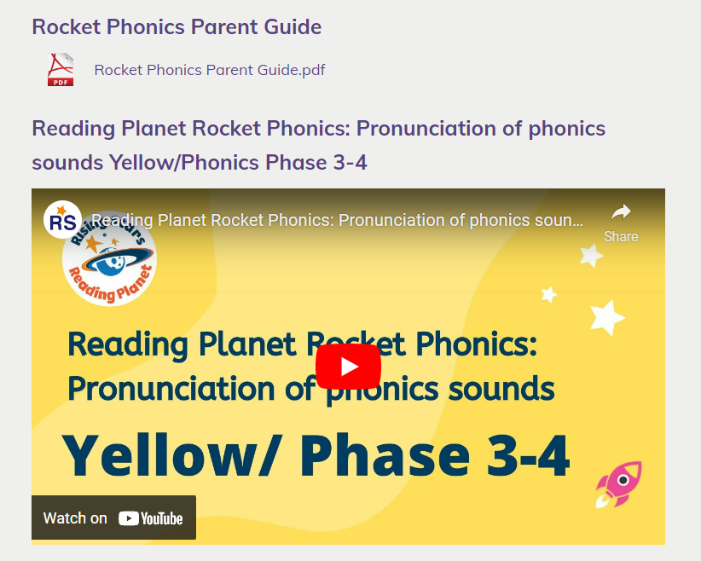
Year 1 Phonics Screening
How can I help my child at home?
Rocket Phonics videos are available on the class page
Oxford Owl: Phonics
www.phonicsplay.co.uk – games for sorting real and pseudo words

Slide 20

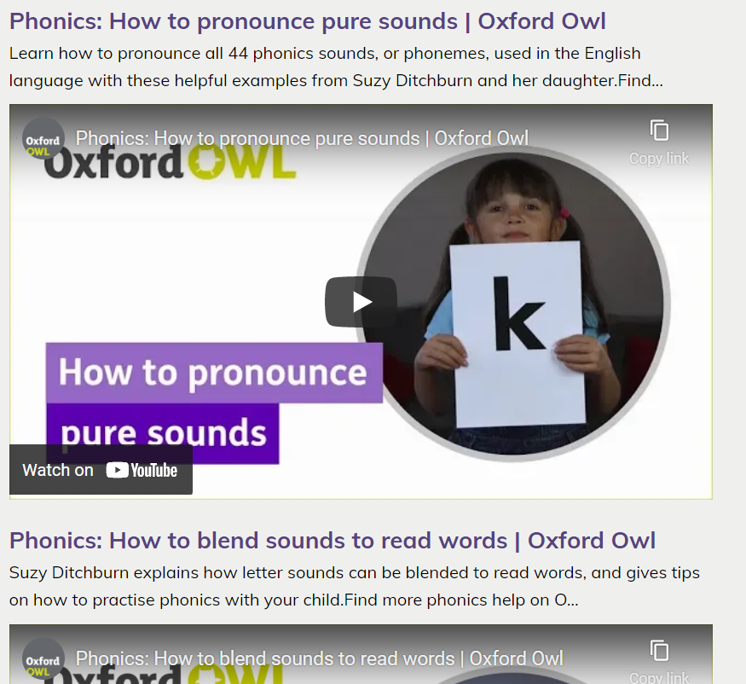
Supporting your child to read

Slide 21
Top tips for helping your child to read
Keep it as quiet and relaxed as possible
During the early stages of learning to read ‘blending’ is a key skill, using ‘pure sounds’
Children need to develop a range of skills in addition to the primary use of phonics to ‘read’ e.g., picture clues, initial sounds, grammatical awareness, contextual meaning, sight vocabulary, using patterned or repetitive language
Comprehension is essential – talk about the books: about the pictures, the characters, how they might be feeling and why, how they think the story will end, their favourite part
Praise and more praise
Enjoy it! Reading should be an enjoyable experience. If it is a constant chore or battle, leave it. Also, read to them and introduce them to tricker vocabulary – this is a great way of improving their understanding of language.
Please speak to us if you are having difficulty getting your child to read with you.

Slide 22
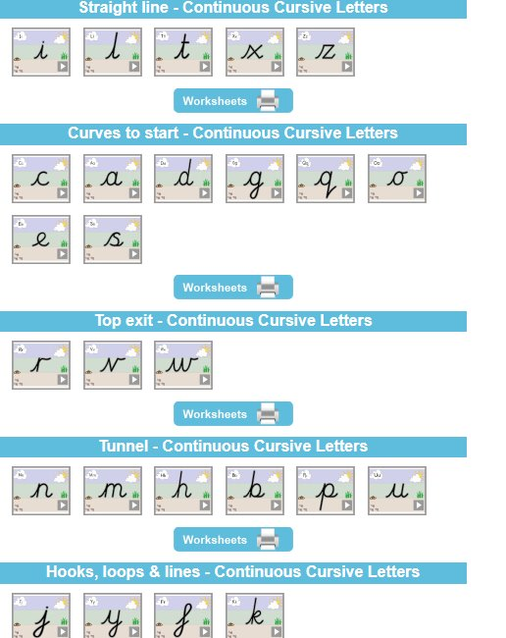

HANDWRITING
Throughout KS1, once the formation of all letters is correct, children then begin to learn to join letters. Cursive handwriting teaches children to join letters and words as a series of flowing movements and patterns.
In year 1 we deliver daily sessions.
Continuous Cursive letter choice 2 beginners (teachhandwriting.co.uk)

Slide 23
Easy ways to support writing at home
Help your child learn the letters of the alphabet and their sounds of the week/ tricky words. The children love singing this alphabet song and tricky words song in class:
https://www.youtube.com/watch?v=ffeZXPtTGC4 https://www.youtube.com/watch?v=R087lYrRpgY
2. Take pictures of an activity that is especially interesting to your child. Use them to write a story together.
3. Keep a portfolio of your child's writing attempts. At different times in the year, show your child their writing samples and comment on their progress.
4. Have writing materials to hand whenever you go out; such as, colourful stationery, envelopes, post its, stickers, lined paper.
5. Celebrate your child's writing by prominently hanging their work in places where it is visible to all. Knowing that writing is important will go a long way toward motivating them to write more.

Slide 24
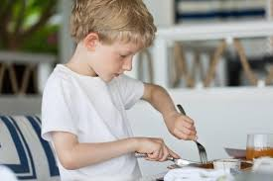
Easy ways to support writing at home
Utensil use is a practical way to help your child develop their fine motor skills. Supporting your child to use a knife and fork will help to prepare them to write as it will improve their finger dexterity and strength.
Ideas of Fine Motor Activities:
Cutting with scissors
Transferring with tweezers
Threading pasta or beads
Nuts and bolts
Playdough
Pegs – around a container or on a washing line

Slide 25
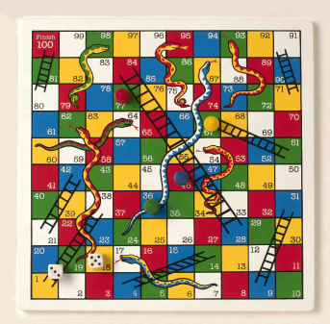
Maths
Things you could support your child with are:
Reading, writing and ordering numbers to at least 20 (especially 11-19)
Learning the number facts for 10 (and 5)
Understanding simple mathematical vocabulary e.g. more than/less than
Play games such as Snakes and Ladders, Ludo, Shut the Box, Card games, Sudoku, etc
Collect acorns/conkers/leaves – can they group them? How many do they have of each? Use vocabulary such as more, most, greater than, fewest, less than.

Slide 26

PSHE
Our PSHE scheme is called LifeWise and it covers areas such as:
Health and Wellbeing
Relationships
Living in the Wider World
Please take the time to read the ‘Parent’s Document’ on our PSHE page to familiarise yourselves with the content that will be delivered to your children.
https://www.ethelbert-road.kent.sch.uk/lifewise-scheme/

Slide 27
P.E.
Our P.E. lessons are every Wednesday. Please could the children come into school wearing their P.E. Kit. This term we will be developing our multi-skills: Throwing and Catching.
PE Kit:
-Purple hoody with school logo
-Purple T-shirt with school logo
-Black Shorts
-Black tracksuit bottoms or black leggings
-Sports trainers
If your child wears stud earrings, please could they be removed every Wednesday. If stud earrings cannot be removed, please could you tape over them. Thank you for your cooperation.
During Term 6 we will be going to Faversham Gym. Parent helpers will be needed to walk to and from the gym.

Slide 28
Uniform
Winter
Purple sweatshirt, cardigan or fleece with school logo
Yellow polo shirt with school logo
Smart grey trousers or smart grey shorts
Grey skirt or grey pinafore dress
Grey, black, white or coloured socks or tights
Sensible, easily fastened coats
Black shoes or black flat boots (no trainers or
high heeled shoes please)
Summer
-Purple Sweatshirt, cardigan or fleece with school logo
-Yellow polo shirt with school logo
-Smart grey shorts or smart grey trousers
-Purple or yellow checked dresses
-Light, rain coat
-Black shoes (no trainers or high heeled shoes please) or
closed-toe sandals (no crocs please)

Slide 29



Water bottles & fruit/veg
Please continue to bring in named water bottles.
Of course, if your child forgets their bottle, then we will provide them with a cup and fresh water in class.
Fruit or veg will continue to be supplied daily, available for the children during morning playtimes.

Slide 30
homework
Reading (book change on Friday)
Spellings will uploaded to the class page on a Friday to be informally checked the following Thursday.
Optional topic-based home learning: To encourage home learning and parent engagement each term a list of optional home learning activity ideas will be uploaded to the class page.
Please send in any home learning creations or alternatively photos to the class email. We would love to see what you create together! ☺

Slide 31
Useful websites
The following sites may be useful to help you support your child at home :
Kent ICT www.kented.org.uk/ngfl
ICT games www.ictgames.com
Phonics Play www.phonicsplay.co.uk
You Tube ‘Mr Thorne does phonics’
Topmarks www.topmarks.co.uk - A range of maths and English / Phonics games

Slide 32

Online safety
Our children are growing up in a world which is becoming more and more dependent on and accustomed to the digital world. Technology is such a big part of our lives now; there’s no escaping it and there are many positives that we can gain from it so long as we can navigate it properly. This is why it is crucial that we help our children to learn how to safety participate!
Think of online safety in the same way you would road safety,
we wouldn’t tell our children that they should never cross a road
or even go near a road but we teach them strategies: listen out for
vehicles, look both ways. When they are tiny, children will be carried.
As they get older, they will hold a grown-up’s hand and eventually,
they will cross independently, assessing the risks and using the
strategies they’ve learned.

Slide 33
Online safety
The e-safety page on our school website (https://www.ethelbert-road.kent.sch.uk/e-safety/) details how we ensure we are keeping your children safe in school.​
However, there are many resources available to support parents with teaching online safety at home, including some useful resources that help with filtering and parental controls as well as advice on communication with your children about their online experiences.​
https://www.internetmatters.org/​
https://www.ceopeducation.co.uk/parents/ ​
https://www.nspcc.org.uk/keeping-children-safe/online-safety/talking-child-online-safety/​
https://saferinternet.org.uk/guide-and-resource/parents-and-carers

Slide 34

Class Provision
We are spending the first few weeks of term getting to know your children and assessing whether they need targeted support in the areas of reading, writing, maths, speech or social skills. If your child has been chosen to have provision in these areas, I will be sharing this document with you and explaining how this will take place.

Slide 35
SEND
SEND stands for Special Educational Needs and Disability. Our SENCo (SEN Co-Ordinator) is Mrs Vitiello.
At Ethelbert Road, we constantly monitor the progress and attainment of all pupils. Most pupils make good progress on their learning journey from EYFS to year 6 through our high-quality day to day teaching and our normal provision, following the Mainstream Core Standards (a framework to support pupils with SEND).
Most children need some level of targeted support whilst at school and you will be informed and kept updated if this is the case for your child.
If you have concerns about your child and wish to discuss this further, please speak to me and we can arrange a meeting (if you wish). I will consult with Mrs Vitiello and we will arrange further meetings where appropriate.
If your child has a Special Educational Need they will be placed on the SEN register after a discussion with parents/ carers.
For more information about our SEN provision, including the Mainstream Core Standards and relevant policies, visit our website on https://www.ethelbert-road.kent.sch.uk/special-educational-needs-and-disability/.

Slide 36
Can you help us?
Do you have any talents you can share with us or any expertise our children could learn from?
Do you have any time where you could help out by being a volunteer reader, be part of the school fundraising groups or support in any other way?
Throughout the year we will need volunteers for school trips and our gym sessions during Term 6.
Please let me know if you can help out in any way!

Slide 37
Any Questions?

Slide 38
THANK YOU FOR ATTENDING
We are looking forward to an amazing school year ☺

