Slide 1
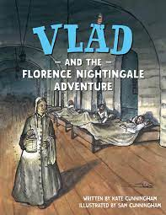
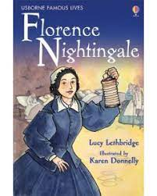
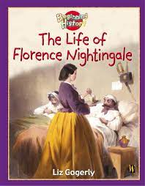
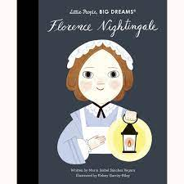
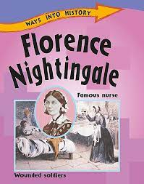
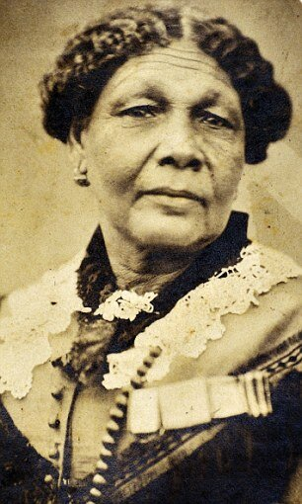
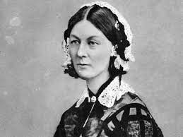
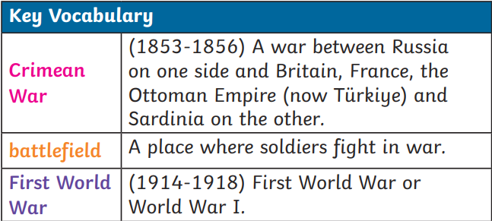
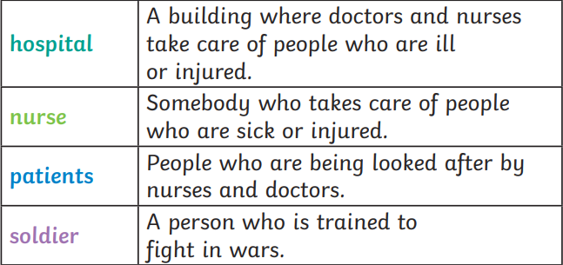
Maths
In maths we will be focusing on numbers to 50, measuring length and height and measuring weight and volume.
We will:
Make representations of numbers to 50
Partition into tens and ones
Compare lengths and heights
Measure lengths using cms
Compare objects by weight
Determine which containers have the most or least volume of liquid.
English
In English we will continue to include adjectives in our writing an we will be using our phonetic knowledge to help with our spelling. We will begin to add ‘and’ to our writing to extend our sentences and join two ideas. We will be introduced to suffixes –ed and –ing.
This term we will:
Look at the features of informal letters and create our own
Write facts about Florence Nightingale and Mary Seacole
Write a recount about our school trip to Kent Life
Exciting Books
Nurturing Nurses
Year 1 Term 4
R.E.
During RE we will be continuing to explore Christianity. We will explore items linked to Christians and discuss what Christians believe about God. We will also listen to the Easter story.
Topic
During topic we will be learning facts about Florence Nightingale and learning about the significant improvements she made to healthcare.
We will explore the differences and similarities to hospitals and nursing over time. We will also make comparisons between Florence Nightingale and Mary Seacole’s lives.
Subject Specific Vocabulary
Spanish
In Spanish we will be learning vocabulary based on food and Easter in Spanish speaking countries.
P.E.
During our PE lessons we will be developing our bat and ball skills and looking at yoga movements.
Science
In our science lessons we will be exploring seasonal changes. We will explore the seasons, the associated weather and hoe the day length varies. We will discuss the appropriate clothing to wear.
Art/DT
In Art we will be enhancing our drawing skills to create portraits of Florence Nightingale. Our artist of the term is Gwen John.
Magic Moments (Enrichment)
During this term we will have a school trip to Kent Life’s Victorian Day (14th March). Nurses will be visiting our classroom so we can compare medical care today to the past.
Computing
In our computing lessons we will be introduced to the concept of data and information. We will be labelling and grouping information and images.
PSHE
In PSHE we will be focusing on understanding difficult feelings and how we can problem solve.
Music
During music we will explore beat and active listening to 20th century classical music.

