Slide 1
Onyx Class
Year 6
Curriculum & General Information

Slide 2
Staffing
Mrs Calzada and Mrs Haylor – Class Teachers (Topic and PE)
Mr Adkins – Teacher (Maths, Science, and Computing)
Miss Clegg and Mrs Willis – Teaching Assistants
Mrs Davis – Teaching Assistant
Mrs Willis – Art/DT Teacher
Mrs Appleton – Science/RE
Mrs Salt – Spanish Teacher
Miss Brown – Sports Coach

Slide 3


Slide 4

Safeguarding
Safeguarding our children is a very important part of our practice and it is important that parents are confident about the school’s arrangements to keep their child safe. https://www.ethelbert-road.kent.sch.uk/safeguarding
If you would like any further information, have any
questions, please do not hesitate to contact the Headteacher/DSL: headteacher@ethelbert-road.kent.sch.uk

Slide 5
SUPPORTING YOUR CHILD
SEND stands for Special Educational Needs and Disability.
Our SEND Coordinator at Ethelbert Road is Mrs Vitiello.
At Ethelbert Road we constantly monitor the progress and attainment of all pupils.
Most pupils make good progress on their learning journey from EYFS to year 6 through our high-quality day to day teaching and our normal provision.
We follow the Main Stream Core Standards.
Most children need some level of additional support whilst at school.
If your child needs additional support, you will be informed and kept updated.
If your child has a Special Educational Need they will be placed on the SEN register after a discussion with parents/ carers.
More information about our SEN provision, including the Main Stream Core Standards is on our website on https://www.ethelbert-road.kent.sch.uk/special-educational-needs-and-disability/

Slide 6
Expectations in Year 6
The children will be encouraged to be far more independent in upper KS2.
The children will move classrooms at break time, encouraging them to be more responsible for their own belongings.
We will be setting weekly homework for the children to complete.

Slide 7
Arrival And Dismissal
The children enter school via the side gate.
The classroom door will open at 8:40am. The children should aim to arrive at this time as they are unsupervised before this time.
The register is taken at 8:50am and the gate is closed at this time.
We use early morning work as time to learn key skills.
Children will be dismissed at 3:15pm.
If someone else is collecting your child, please let us know in the morning or contact the office via email.

Slide 8
Rewards
The Recognition Board
The Recognition Board links with our school rules:
Be Kind, Be Safe, Be Ready. Each week, we choose
one target and aim for every child to get their name
on the board.
House Points
We will award house points to children who follow
the school rules and make progress with their learning.

Slide 9
Uniform
Winter -Purple sweatshirt, cardigan or fleece with school logo -Yellow polo shirt with school logo -Smart grey trousers or smart grey shorts -Grey skirt or grey pinafore dress -Grey, black, white or coloured socks or tights -Sensible, easily fastened coats -Black shoes or black flat boots (no trainers or high heeled shoes please) | Summer -Purple Sweatshirt, cardigan or fleece with school logo -Yellow polo shirt with school logo -Smart grey shorts or smart grey trousers -Purple or yellow checked dresses -Light, rain coat -Black shoes (no trainers or high heeled shoes please) or closed-toe sandals (no crocs please)
P.E. Kit -Purple hoody with school logo -Purple T-shirt with school logo -Black Shorts -Black tracksuit bottoms or black leggings -Sports trainers -Small bag or rucksack (we have limited space so no large rucksacks please) | Book Bag purple or blue book bag. Rucksack - Due to limited space, in the school and classrooms, please could these be small.

Slide 10






Water Bottles and Fruit/Veg
In Year 6, the children will be expected to have a water bottle in school.
The children are allowed to bring in a healthy snack. This could be a piece of fruit, dried fruit, a vegetables, a fruit roll up, healthy crackers, oatcakes, rice cakes, breadsticks or a piece of cheese.

Slide 11
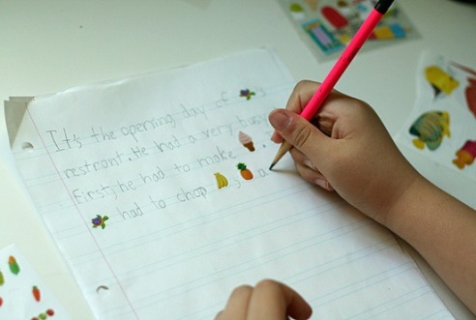

Supporting your child in reading and writing
Reading: Frequent listening to AND reading to your child.
Not just fiction! Questioning and discussing. Library member.
Writing:
Keeping diaries
Letter writing/emailing family and friends.
‘Fun writing’ use coloured pencils or different writing implements.
Shopping lists. Check the class pages for ideas and recommendations.

Slide 12
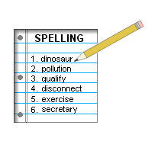
Spelling
Spellings will be set weekly, and they will be posted on the class page for pupils to practise at home. Spelling books will go home on Mondays. Pupils are asked to learn the spellings and write them in a sentence. On Fridays, there will be a spelling ‘check’.
Ways in which you can support your child’s spelling skills and ability:
Practising the spelling of Common Exception Words
Wordle
Sir Linkalot
Crosswords/word puzzles
Playing Scrabble/Boggle/Hangman
www.spellingframe.co.uk

Slide 13

Pencil Cases
General Content:
Pencils
Pencil Sharpener
Glue Stick
Eraser
Ruler
Colouring Pencils

Slide 14
Topic
Mrs Calzada and Mrs Haylor will be leading topic sessions for Year 6. During these sessions, the children will be covering English, history, geography, RE and music objectives.
Term 1 Topics: Science Fiction and Geography of the UK.
Some other topics we will explore: The Vikings, The Highwayman (poetry), Macbeth, Scandinavia, The Ancient Greeks, Faversham - Past, Present and Future.

Slide 15

Termly Curriculum Maps

Slide 16

Class page

Slide 17
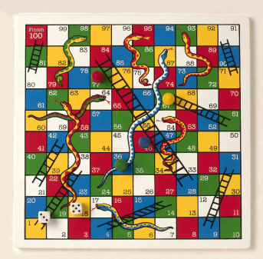
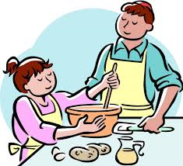


Supporting your child in Maths
Play board games such as Monopoly, Ludo, Backgammon, Shut the Box, Card games, Sudoku, etc.
Encourage your child to be involved with cooking (weighing and measuring) and shopping (using money).
Talk about TIME! Plan events together to help your child to work out timings.

Slide 18
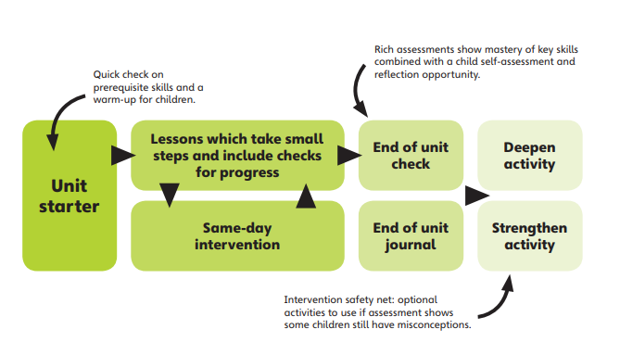
Maths
Mastery Approach

Slide 19
P.E.
Our P.E. session is on a Monday afternoon. We hope
to go over to the Abbey School as much as possible
before winter.
Our gym session will take place next term on a Thursday afternoon.
Please send the children to school in their PE kit on these days.

Slide 20
PSHE
This year, we have introduced a new PSHE scheme covering Health and Wellbeing, Relationships and Living in the Wider World.
Please take the time to read the ‘Parent’s Document’ on our PSHE page to familiarise yourselves with the content that will be delivered to your children.
https://www.ethelbert-road.kent.sch.uk/lifewise-scheme/

Slide 21
Homework
Spellings
Spellings will be set each Monday, and checking will take place on Friday.
Maths
Children will receive maths homework related to the week’s learning on a Wednesday to be completed by the following Monday.
Topic-Based Home Learning
The children will sometimes be set project-type home learning tasks related to our topic learning in class.
Reading
At least fifteen minutes each day.

Slide 22
Communication
Please speak to us if you feel there is anything we need to know.
The year group email is y6@ethelbert-road.kent.sch.uk
Please contact the school office about absences.
If you would like to talk to someone in confidence about a safeguarding issue or family circumstances, please speak to Mrs Kirkbride who is our Designated Safeguarding Lead. In her absence, please speak to Mrs Vitiello or Mrs Cornall who are the Deputy Designated Safeguarding Officers.

Slide 23
Communication
Each year group has their own email address to help parents communicate with their child’s teacher. Please note that the teachers will check their emails Monday-Friday between 3:30-4:00pm. Due to the teacher’s workload, we may not be able to respond on the same day, however please be reassured they will get back to you as soon as possible. If you have an urgent issue, please contact school via the school office.​
​
Please continue to email the office with any absence/holiday/medical issues and general enquiries.​

Slide 24
Provision Maps
We have spent the first few weeks of term settling in,
and assessing whether the children need extra support
in reading, writing, maths, speech or social skills. If your
child has been chosen to have additional provision in
these areas, we will be sharing their provision with you,
and explaining how this will take place. Please do not
worry about this at all.
Provision maps should be coming home soon.

Slide 25
Online Safety
Our children are growing up in a world which is becoming more and more dependent on and accustomed to the digital world. Technology is such a big part of our lives now; there’s no escaping it, and there are many positives that we can gain from it, so long as we can navigate it properly. This is why it is crucial that we help our children to learn how to safely participate!​

Slide 26
Online Safety
Think of online safety in the same way you would road safety, we wouldn’t tell our children that they should never cross a road or even go near a road but we teach them strategies: listen out for vehicles, look both ways. When they are tiny, children will be carried. As they get older, they will hold a grown-up’s hand and eventually, they will cross independently, assessing the risks and using the strategies they’ve learned.

Slide 27
Fundraising Group
Miss Hills has some plans for the year ahead,
so please keep an eye out for those opportunities.

Slide 28
Kent Test and Secondary Transfer
Kent Test results will be emailed to parents on
Thursday 17th October.
2nd September: Online application process
opened for admission to secondary schools in Kent.
Thursday 31st October: Online application process closes.
Monday 3rd March: Offers of school places sent to
parents.

Slide 29

Applications for 2025
You can apply for up to 4 schools.
Put the schools in the order of preference.
It’s in your best interest to list 4 schools.
Naming only one school does not guarantee your child a place at that school or give priority for a place over another child.
You are not able to name the same school more than once.
To apply to a school outside of Kent, name the school in your application with your other preferences. Your application details will be passed on to the relevant local authority for processing.
Applications are processed between 1 November 2024 and 1 March 2025.

Slide 30
End of KS2 SATs
-The SATs take place in May.
-They comprise of several Maths papers, a Reading Comprehension paper and an English Grammar, Punctuation and Spelling paper.

Slide 31

Kingswood Residential

Slide 32
Any questions?
Thank you for coming.
We are looking forward to a fantastic year.

