Slide 1




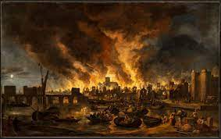
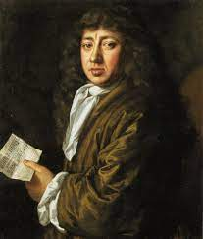
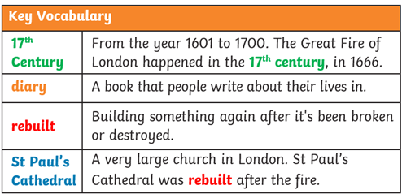
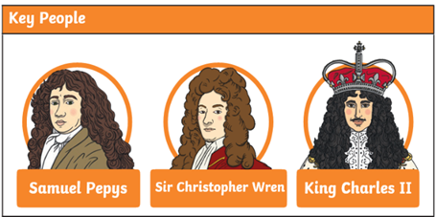
Maths
In maths there is a focus on having a secure understanding of place value within 10.
We will be:
Sorting and counting objects
Counting backwards
Finding one more and one less
Using the part-whole model
Writing number sentences
English
In English we will be practising our sentence writing including using capital letters, full stops and finger spaces. We will write lists, captions and begin to explore diary entries when we discuss the diary of Samuel Pepys.
We will have a daily phonics lesson and participate in different phonics games within child-initiated play. Reading in class will be a combination of whole class, guided (group) reading and individual reading sessions.
We will be participating in weekly Write Dance and Dough Disco sessions to develop our fine motor skills for writing.
Exciting Books
The Great Fire of London
Year 1 Term 1
R.E.
During term 1 we will be exploring Judaism and looking at the question:
Who is Jewish and what do they believe?
Topic
We will be finding out key facts about The Great Fire of London and begin to develop our understanding of what a reliable source is. We will be comparing the differences and similarities of buildings, people and transport in London from the 17th century and now.
Subject Specific Vocabulary
Spanish
In Spanish we will be learning to introduce ourselves, greet others and say how old we are.
P.E.
Wednesday: Multi Skills- Throwing and Catching
Friday: Gymnastics
Science
In our science lessons we will be beginning to explore what science is, what it means to be a scientist and what skills we will be using throughout our time in year 1.
We will then begin to look at and name different materials.
Art/DT
In our art lessons this term we will be developing our skills in colour mixing and creating light and dark shades.
Magic Moments (Enrichment)
Exploring our new classroom
Our new Year 5 buddies
Computing
In our computing lessons we will explore technology around us and how it can help us in our everyday lives.
PSHE
In PSHE we will be discussing our likes and dislikes and different emotions.
Music
During our music sessions we will explore the different sounds that we and different instruments can create.

